Slide 1
POULTRY SCIENCE: Broiler Breeders
Unit 10

Slide 2
Poultry Science: Broiler Breeders
Unit 10: Segment 1
Terminology & Introduction to Broiler Breeders

Slide 3
Terminology
Pullet – a young hen less than one year old
Cockerel – a young rooster
Hen – a mature female (domestic fowl)
Rooster – a mature male (domestic chicken)
Broiler – chicken raised for meat.
Broiler Breeder Parents, Grandparents, & Great-Grandparents – the parents, GP, and GGP of the genetic stock

Slide 4
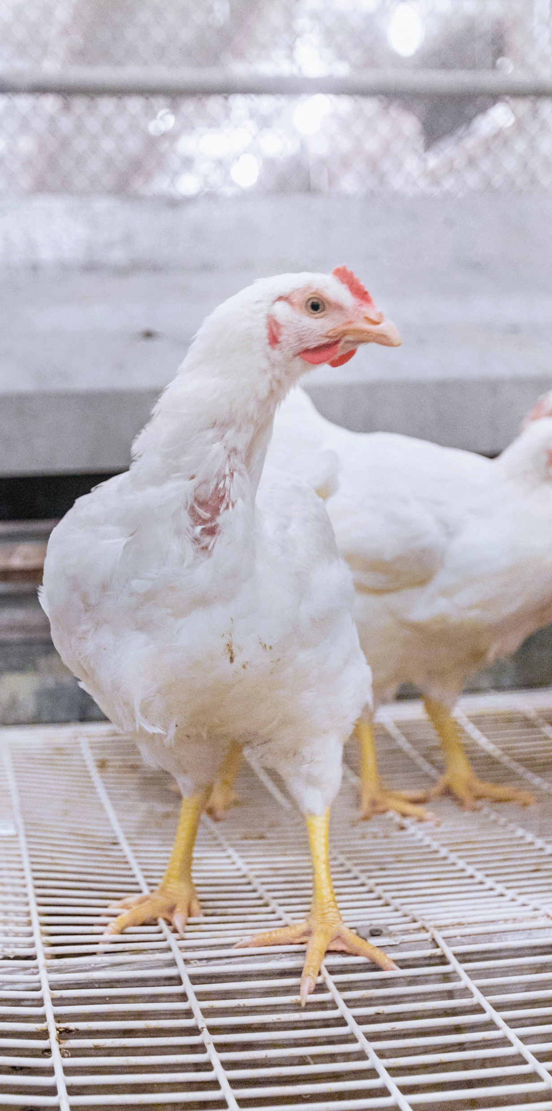
Broiler Breeders
Broiler Breeders – the parents of the meat birds we eat.
Poultry companies buy breeders at one day old based on
Rate of Gain (meat deposition)
Feed Conversion (Feed:Gain)
What best meets their product mix
They manage the parent stock to maximize fertile egg production.
Parent Stock:
Do not like to lay eggs
Do not like to mate
Become top heavy over time

Slide 5
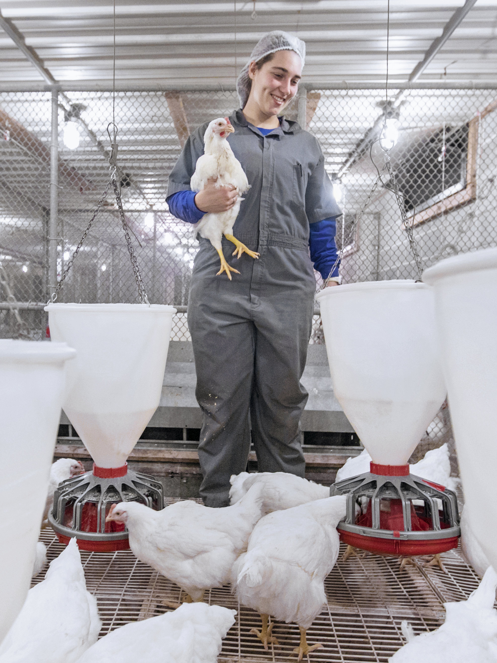
Primary Breeder Companies
Parent chicks are sold by genetic Primary Breeder companies:
Cobb-Vantress (AR)
Aviagen® (AL)
These companies hold Grandparent (GP) & Great Grandparent (GGP) lines that make parent chicks.
They have other parent and genetic lines all over the world.
Their parent stock have been selected for marketable traits (gain, feed conversion, etc.) for over 50 years!

Slide 6
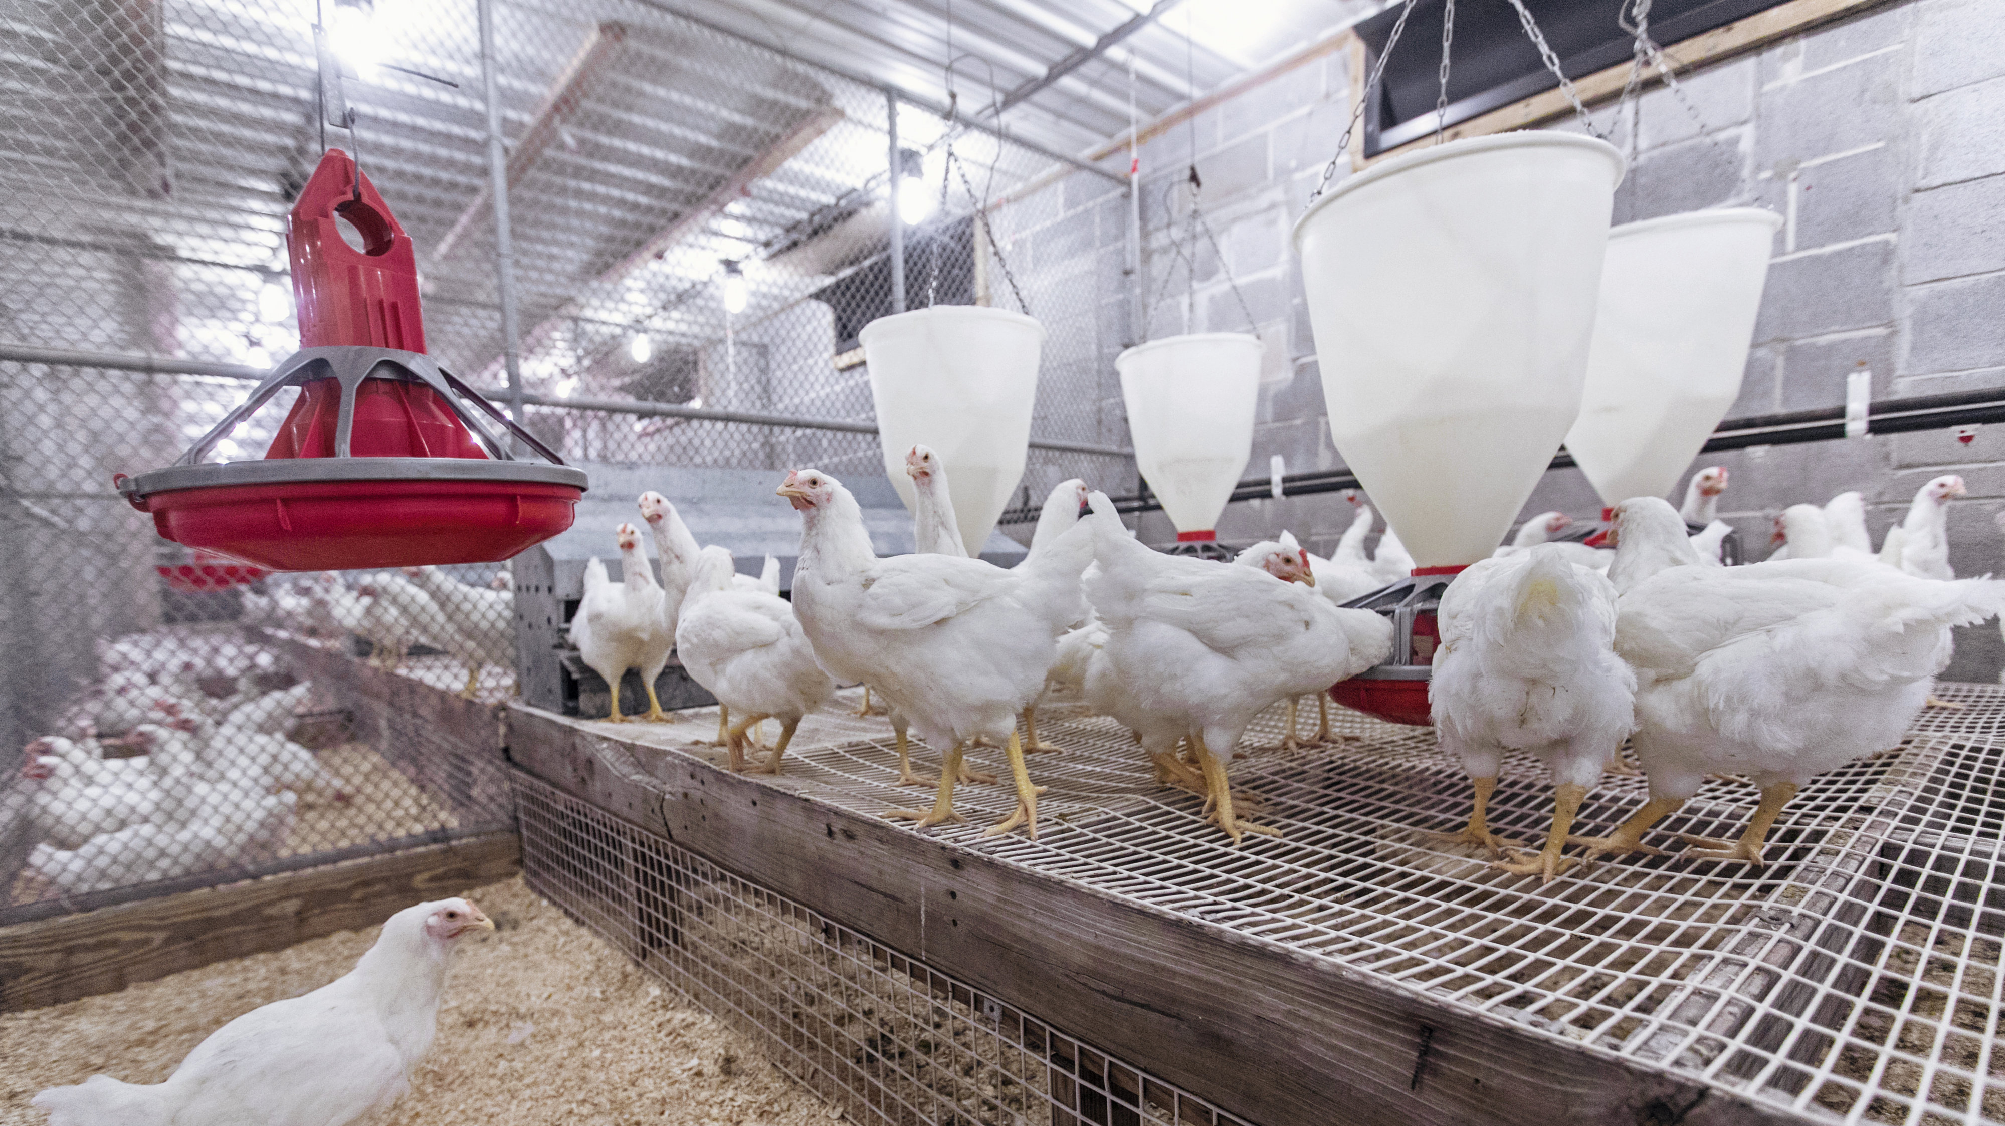
Broiler Breeders & Meat Industry
Meat Industry:
Relies on natural mating
81-83% hatchability yearly as an industry
Birds must be fit enough to complete mating
There must be vent to vent contact during the mating process!
Breeder Goals:
Each year is more difficult due to breeding for meat deposition, not reproduction traits.
Grow and maintain breeders that optimize reproduction through proper feed restriction.
Minimize growth in order to optimize reproduction.

Slide 8
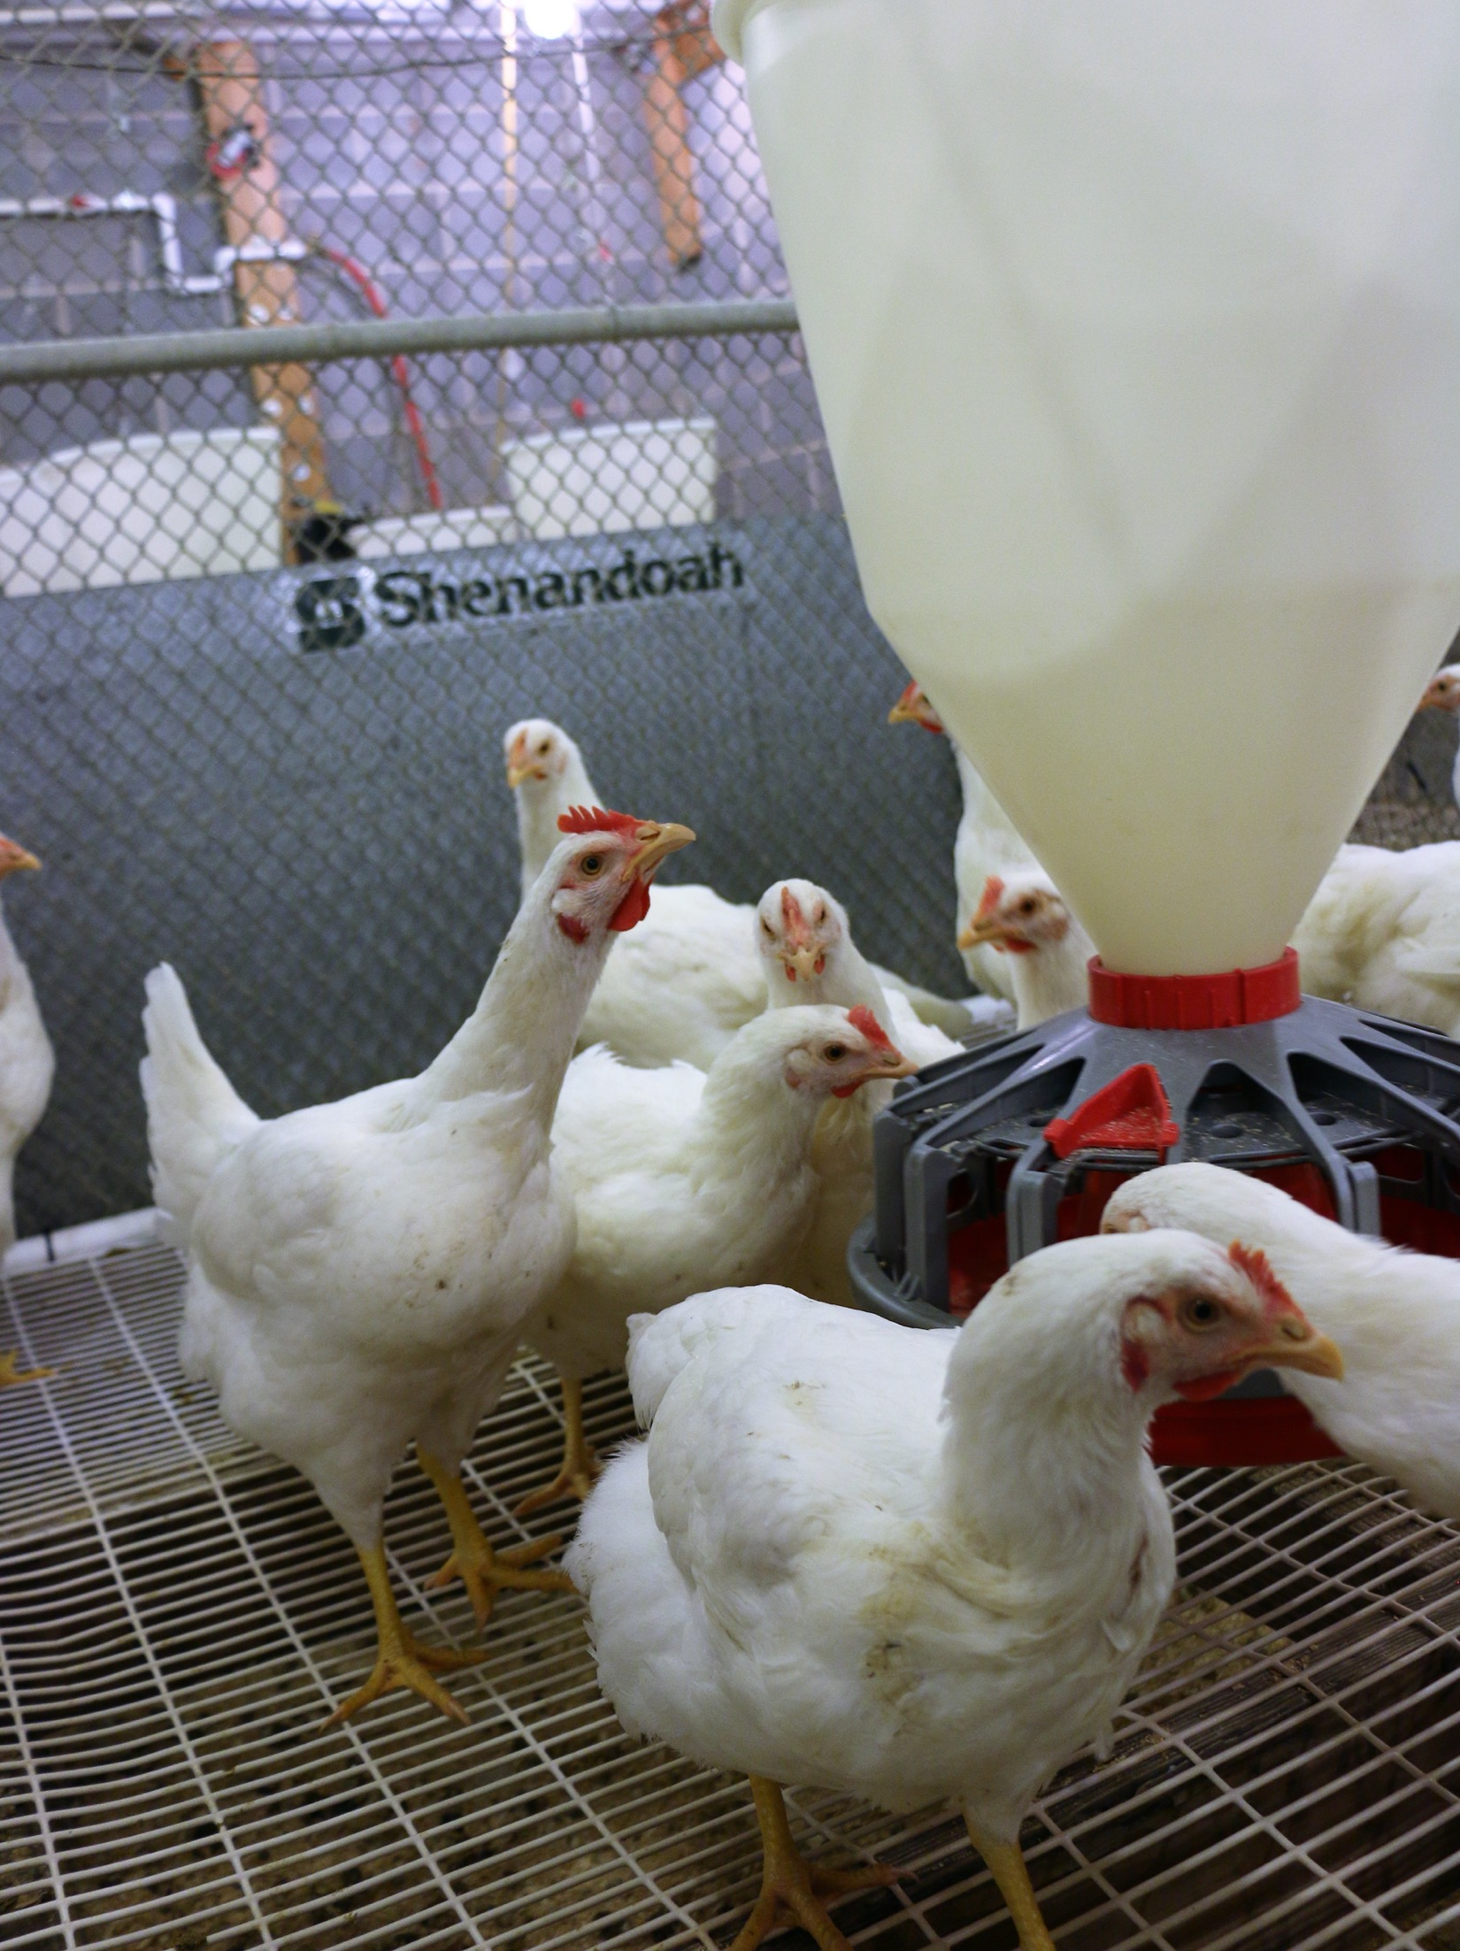
Broiler Breeders
Males and Females are Reared Separately:
Pans or chain feeders for males
¼ to ½ lb. per pullet of feed can be saved using pan feeders instead of chain feeders because they give more space between feeders!
Pancake feeders for brooders
Air inlets (dark-out materials)
Exhaust fans
Slats to train the birds to perch
When grown together, the males are restricted which can lead to decreased teste quality as well as easily overfeeding pullets

Slide 9
Poultry Science: Broiler Breeders
Unit 10: Segment 2
Photostimulation & Nesting Behaviors

Slide 10
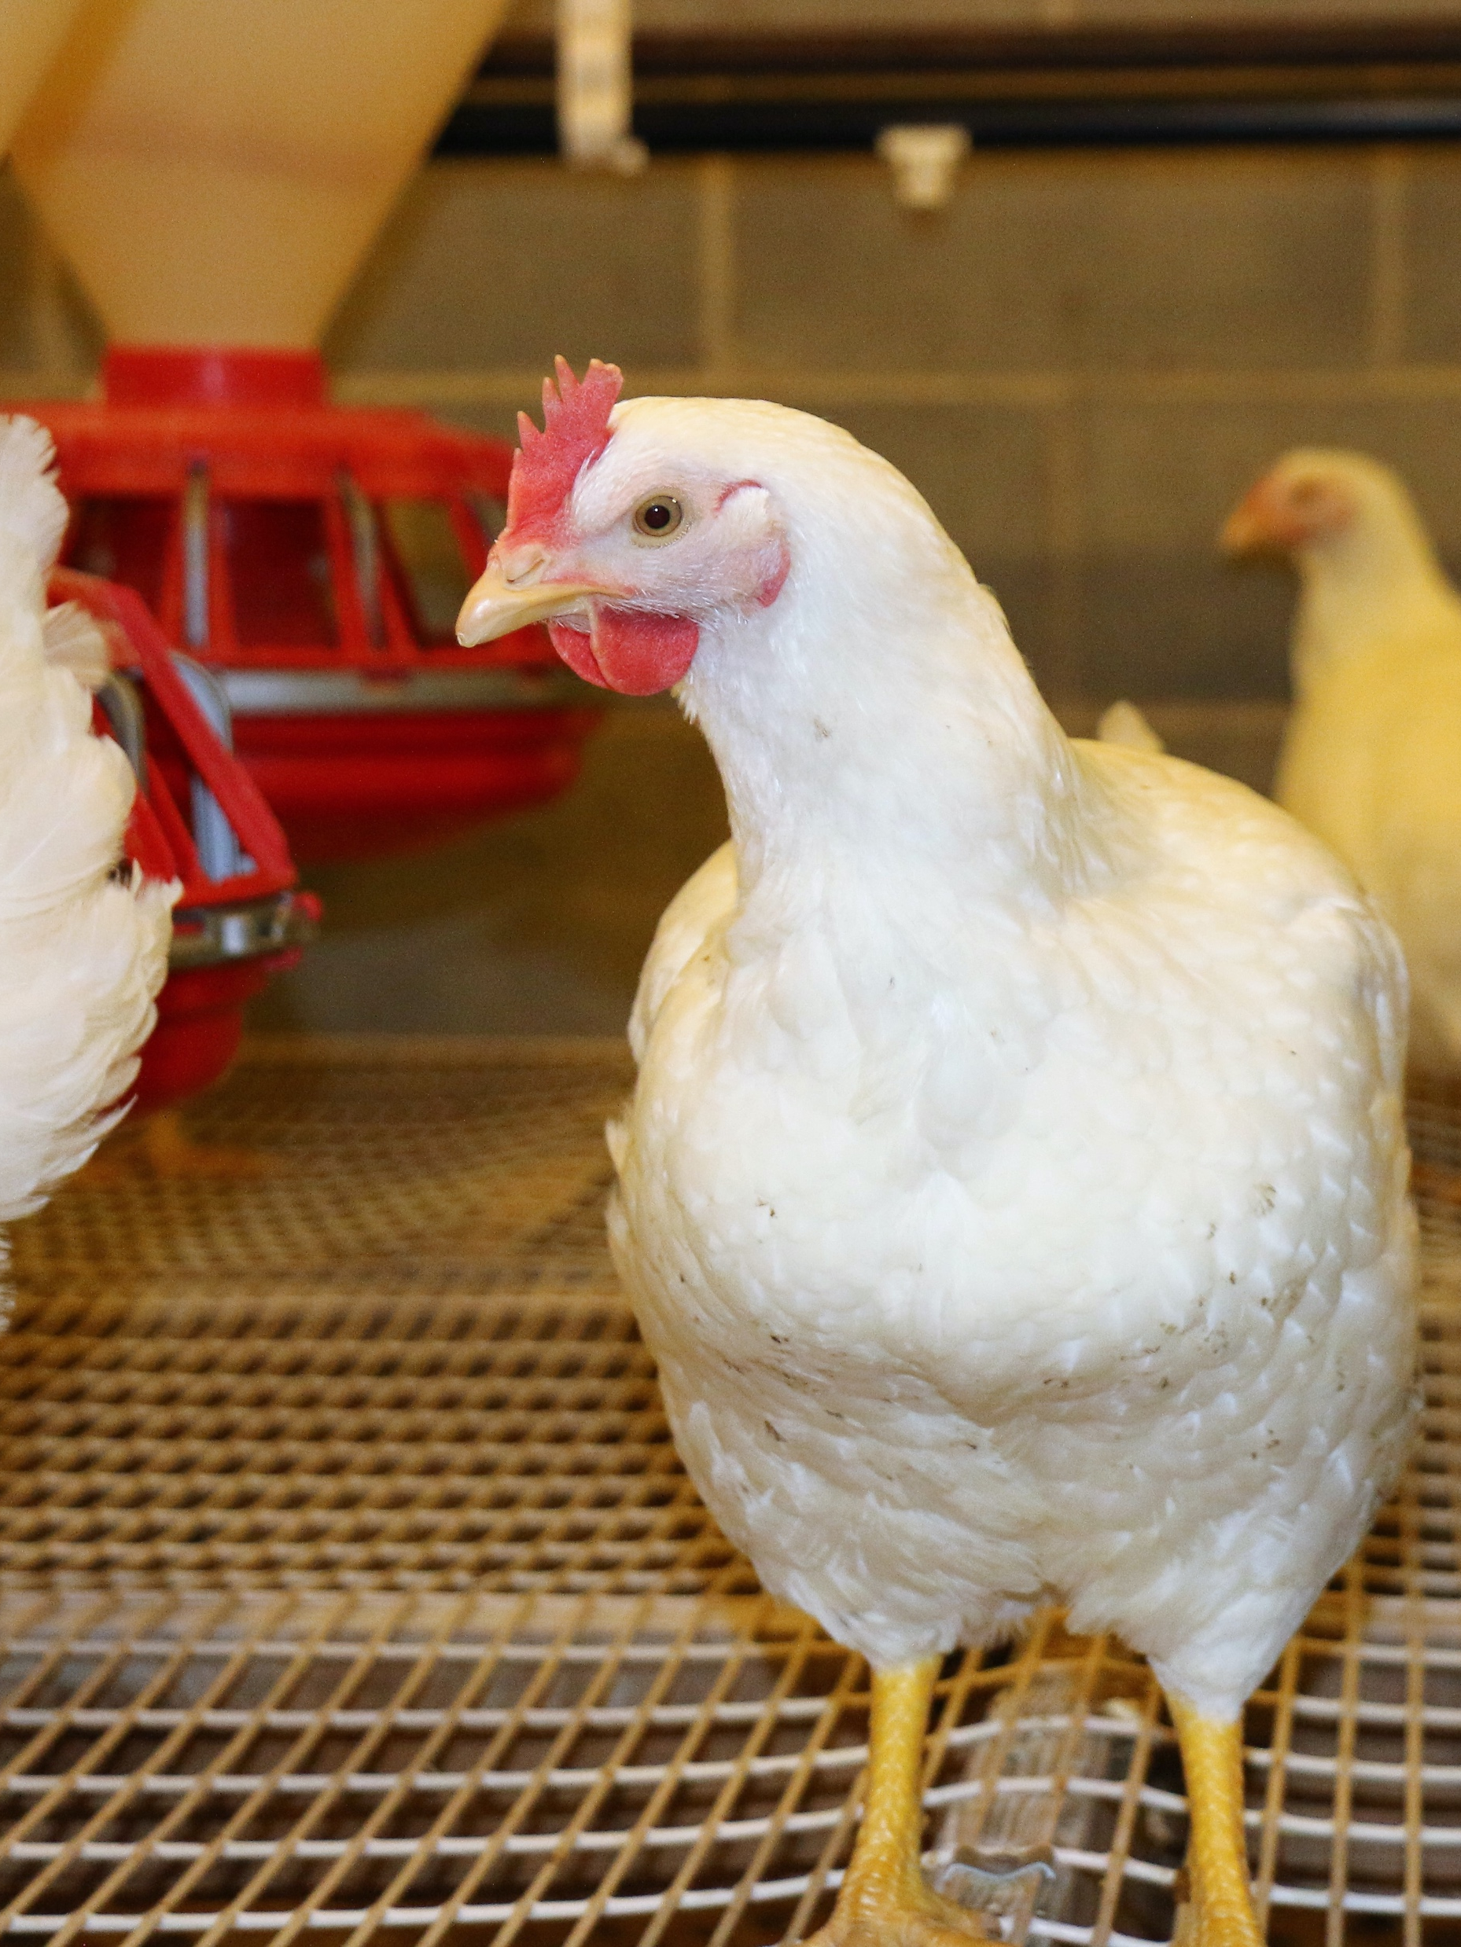
Broiler Breeders & Light
Chickens are seasonal breeders that are stimulated by long day-length (greater than 12 hours of light)
Birds respond to light intensity in an all-or-none manner
If the light intensity is high enough for the bird to recognize a difference from the dark period, the light period is initiated.
Light distribution in a house can be a problem, so producers add lights in dim areas (like around cool cells, etc.)
Utilize reflective services/colors to increase light level in house (white ceilings, walls, etc.)

Slide 11
Photostimulation
Photostimulation – the use of light to artificially activate biological compounds, cells, tissues, or even entire organisms.
Causes the birds to initiate hormone production
At 20-21 weeks of age, go to 14-16 hours of light to photostimulate to sexual maturity
Birds respond to long wave-length or spectrum of light (red, yellow, orange colors)

Slide 12
Photostimulation: Important Points
Birds must be near adult body weight and age at time of photostimulation
If underweight, the birds will ignore the long day length and mature when they reach adult body weight which will result in lower egg production.
If flock is in good condition (uniform body weight), the first eggs can be expected in 2-3 weeks after the birds are given long day length.

Slide 13
Broiler Breeders
Where the hen decides to lay eggs affects how many eggs that can be harvested:
When hot, they may not want to get in the nests.
Bell drinker causes ”false nest” (anything they can get underneath).
Broken eggs attract rodents and flies.
Alternative sites for lay will often result in a decrease in eggs sent to the hatchery.
Egg Room:
Broiler Breeder farms have egg rooms, where the fertilized eggs are stored.
It is vital for this room to stay clean and free of clutter to deter rodents, etc.
Eggs are picked up twice a week.

Slide 14
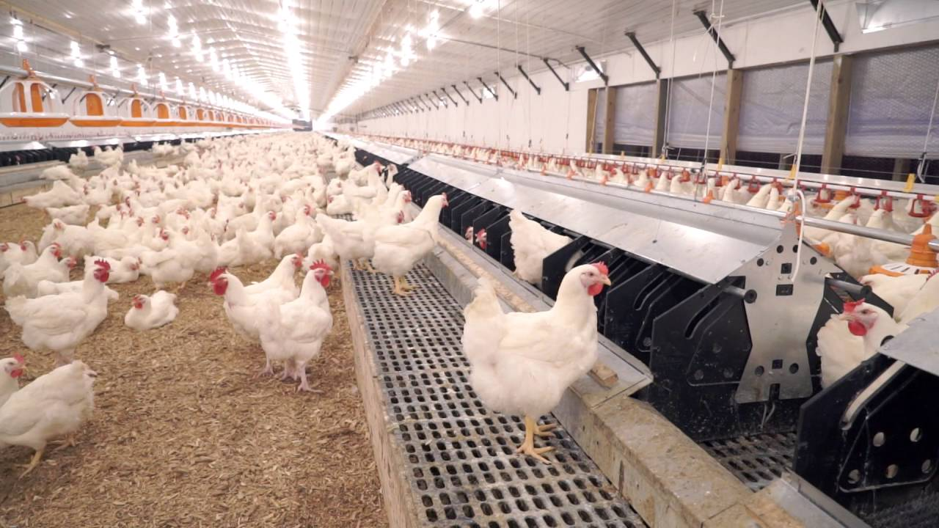
Nesting
Conventional Nests:
4 Hens per nest
Labor intensive but high quality
Commonly used outside the U.S.
Mechanical Nests:
Used in large majority of U.S. farms
5-6 Hens per nest
Easy access
Doesn’t check nests as often
More likely to get hairline cracks and damage

Slide 15
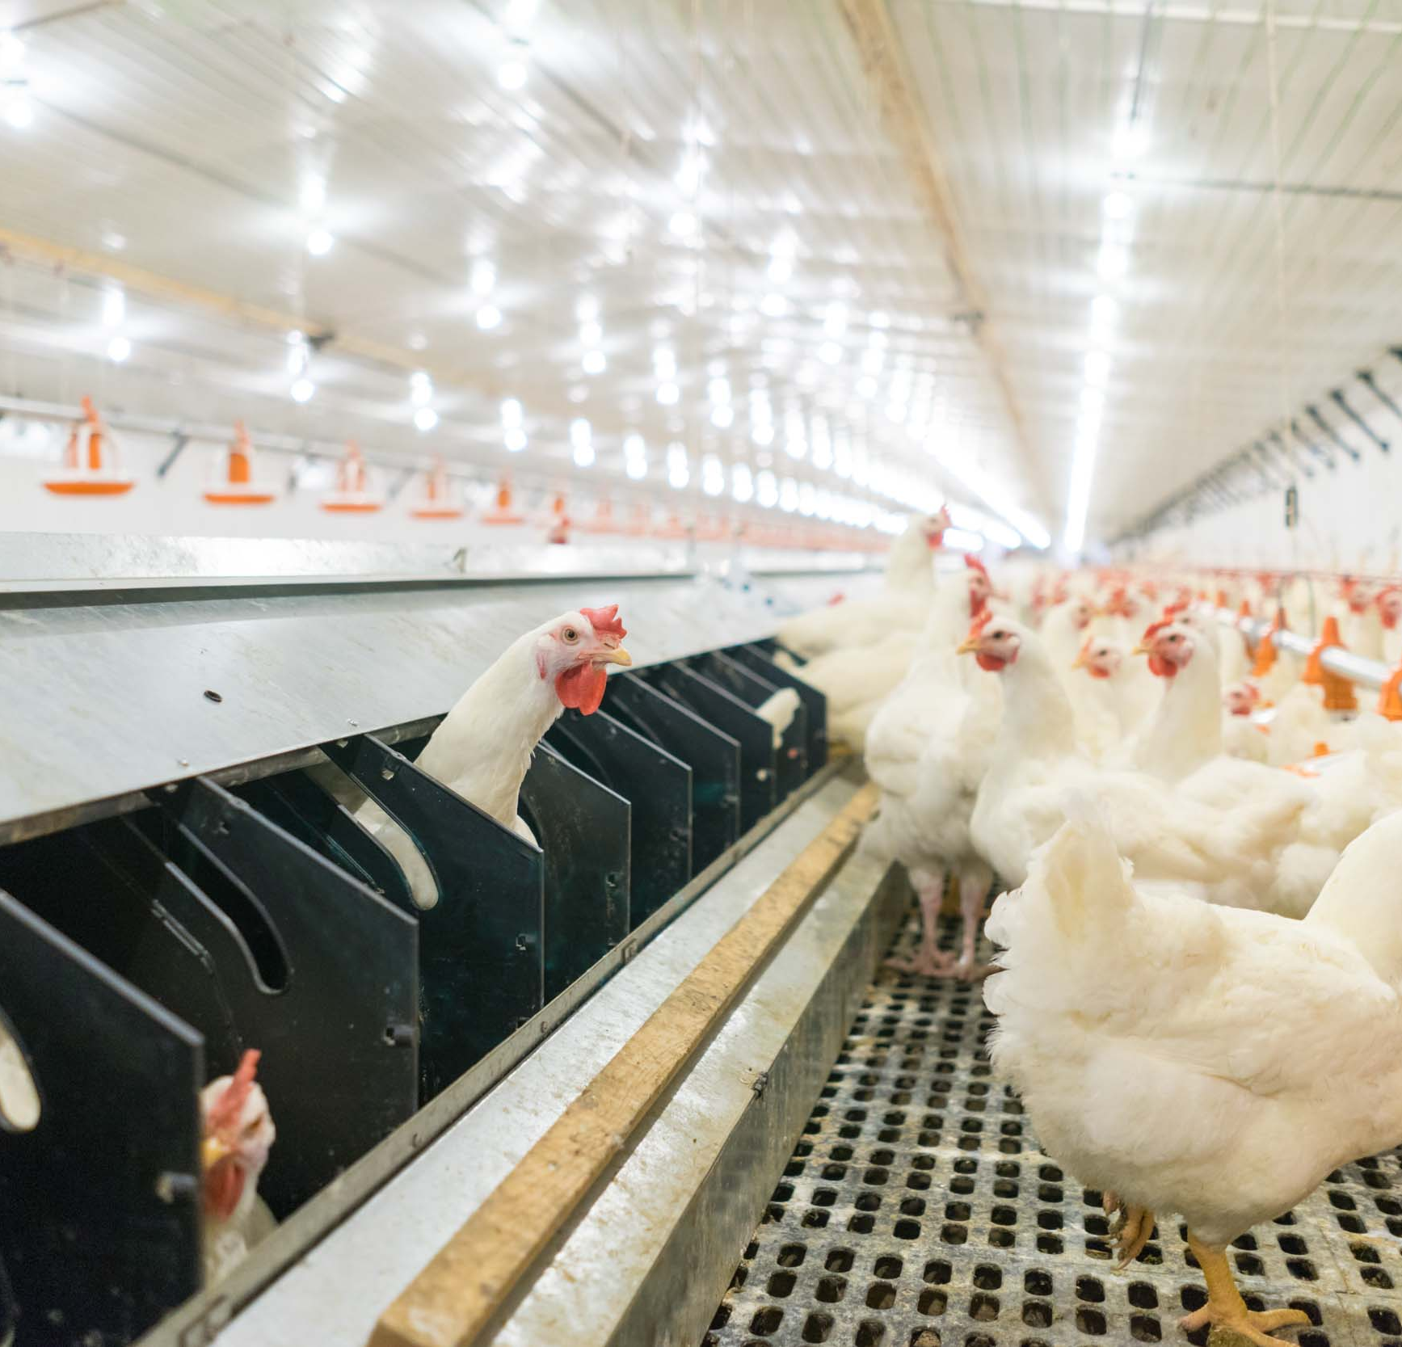
Nesting
Nest Site Selection:
Critical that hens find the nests to lay their eggs.
They will begin looking for nesting sites 1 week prior to first egg!
If they lay in alternative sites, eggs will be lost due to contamination or damage.
Chickens are creatures of habit, so it is important to establish good habits from the beginning! If they lay 3-6 eggs in a location, they will attempt to return to that site or one similar.
She needs to be comfy!
Encourage birds to calm down after arriving by spending time with them.

Slide 16
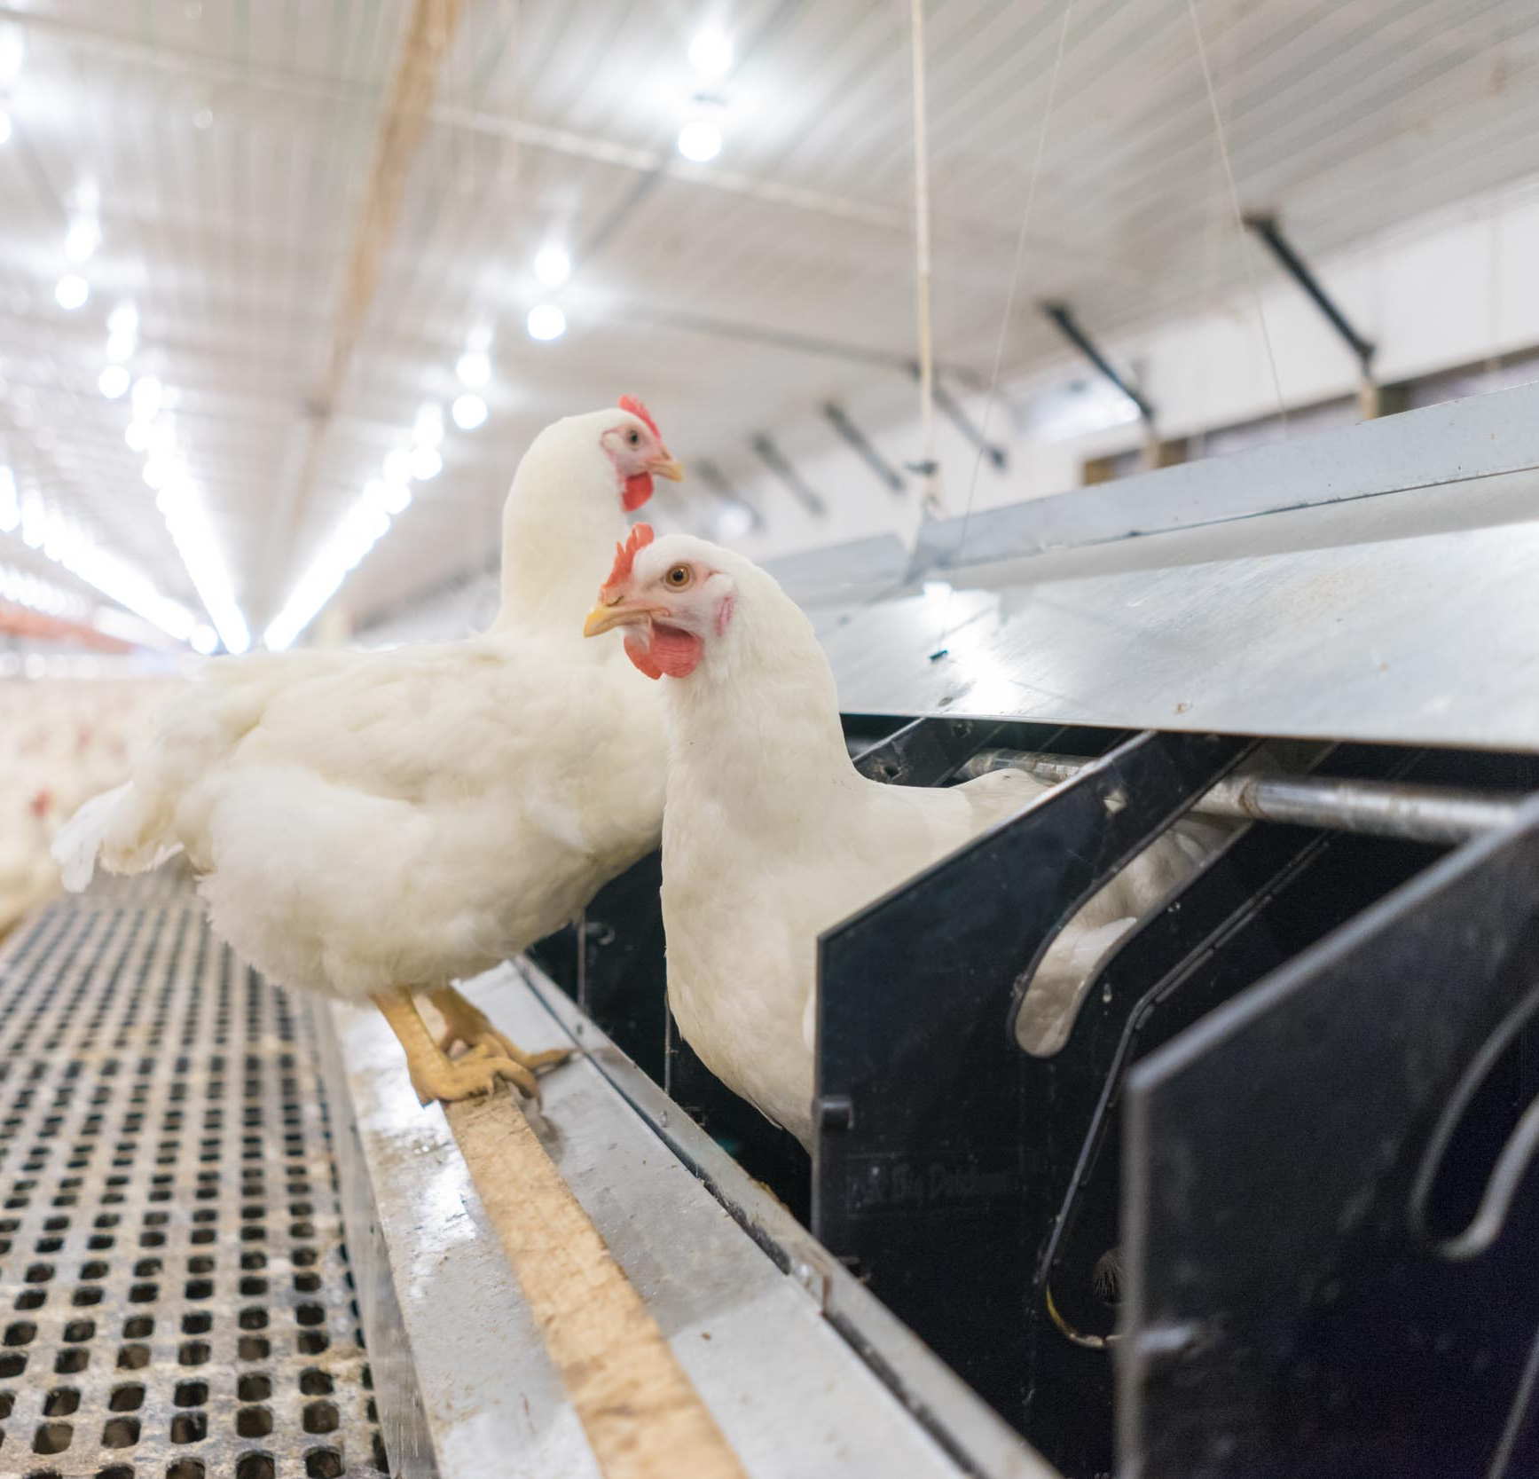
Nesting
Nest Behavior:
Hens are drawn to enclosed area that gives them a sense of security
Prefer a concave surface with loose nesting material
Discourage laying in alternative sites (on/under slats, under feeders, etc.) by reducing areas that might interest them as a possible nest.

Slide 17
Poultry Science: Broiler Breeders
Unit 10: Segment 3
Mating Behavior & Artificial Insemination

Slide 18
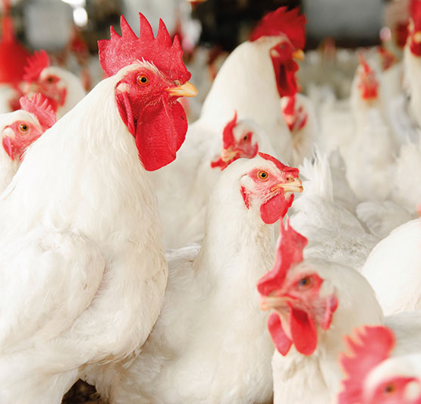
Mating Behavior
“The Waltz” - rooster drops 1 wing and walks around the hen of interest, and the hen will squat.
Rooster will sit on the hen’s back (his keel bone to her spine), and complete mating process. Cloacal contact is required for this!
There is a spike in mating after feeding and will slack off around mid-day.
Before the lights go out, a majority of the mating will happen.

Slide 19
Mating Behavior
Factors Affecting Mating Behavior:
Age
Body Weight & Breast Fleshing (size)
Sex Ratio
Physical Condition (feet & legs)
Pecking Order or Dominance: Set by body size and head appendages (comb & wattle size)

Slide 20
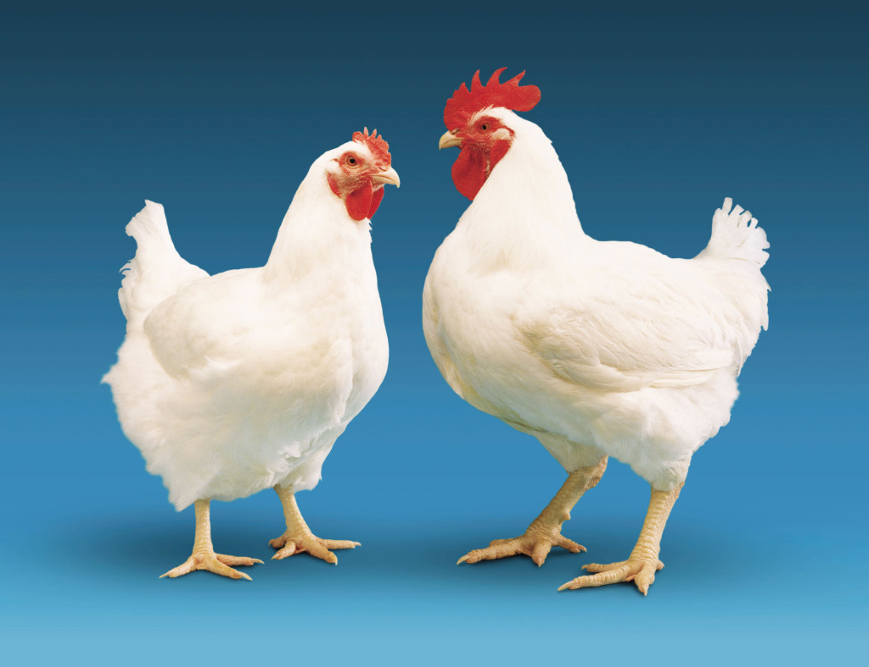
Body Size & Conformation
Body size and conformation is very important in breeders and can be evaluated by the following:
Weighing
Fleshing (looking at breast size)
Shank Color
Red does NOT = Fertile!
Comb Size & Color
Comb size relates to teste size
Purple combs = high nitrogen levels in the blood

Slide 21
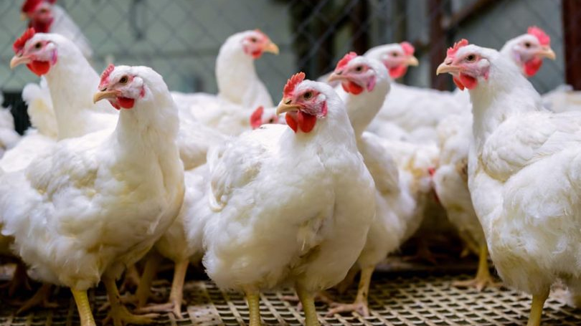
Sex Ratio
Too Low Sex Ratio:
Can result in low fertility due to low mating frequency
Can be fixed with the addition of more males
Will lose early fertility and hatch if not corrected early!
Too High Sex Ratio:
Hens learn to run/avoid the males
Poor fertility
High mortality/injury
Too high competition among males for feed and females

Slide 22
Artificial Insemination (AI)
Insemination:
A minimum of 100,000 spermatozoa into the vagina every 7 days will provide 95-98% fertility.
Rooster semen is more concentrated
3.5 - 5.5 million spermatozoa per ml
Avian semen does not freeze well.
Fertility:
Spermatozoa must penetrate the germinal disc
Hens are inseminated after 3pm to ensure that the spermatozoa can reach the sperm storage tubules.
If done prior to 3pm, an egg in the shell gland of the oviduct will impede the sperm from traveling through the oviduct.
Majority of mating during the last 4 hours of light

Slide 23
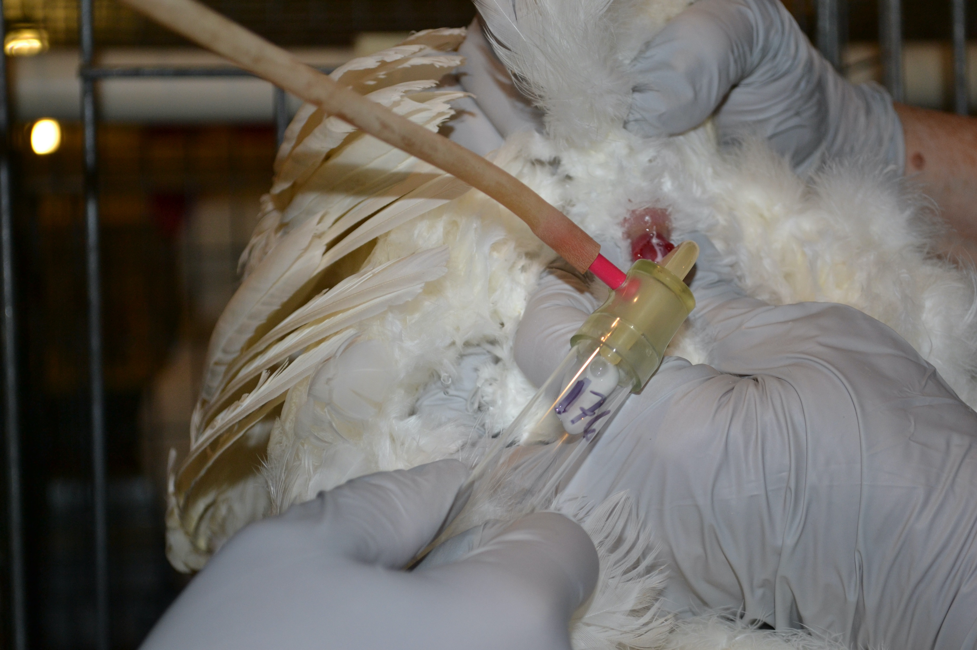
Artificial Insemination (AI)
1.) Collect Semen:
Hold rooster so that he feels secure, with his keel bone laying flat on a solid surface
Glide hand from hips to tail
Very important to avoid contamination!
Semen needs to be used within 30 minutes of collection

Slide 24
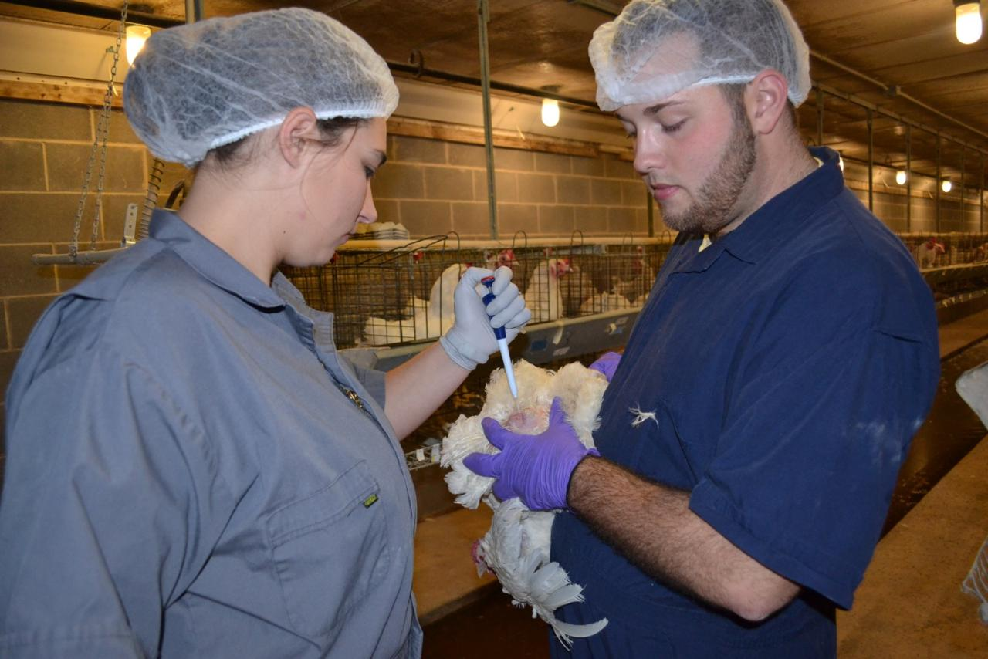
Artificial Insemination (AI)
2.) Then, with the Hen:
Hold hen so that she feels secure, with her keel bone laying flat on a solid surface
Apply light pressure under vent
Insert semen straw in left opening about 1 inch
0.05 ml of semen
If you do not relieve pressure, the semen will come out.

Slide 25
Poultry Science: Broiler Breeders
Unit 10: Segment 4
Broiler Breeder Housing

Slide 26
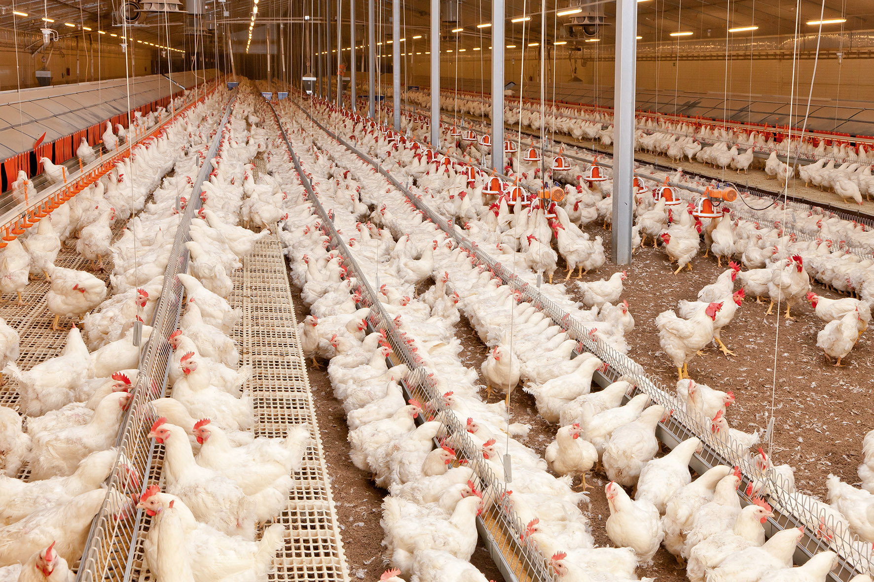
Housing for Broiler Breeders
40 x 300-500 feet
Most common size: 40 x 425 feet
Feed equipment works best if you do not exceed 450 feet since feed chains run the length of the house and loop back (800-950 feet)
Adequate nipple drinker lines
Uniform lighting throughout the house

Slide 27
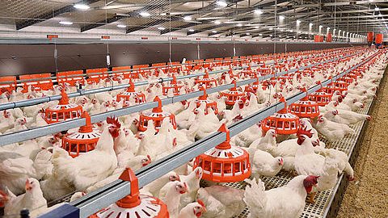
Housing for Broiler Breeders
Rearing (Pullet) House Specs:
Pullets and cockerels (21 weeks of age)
Light tight (meaning no natural light can get in)
All litter flooring
Feeders and drinkers
Evaporative cooling

Slide 28
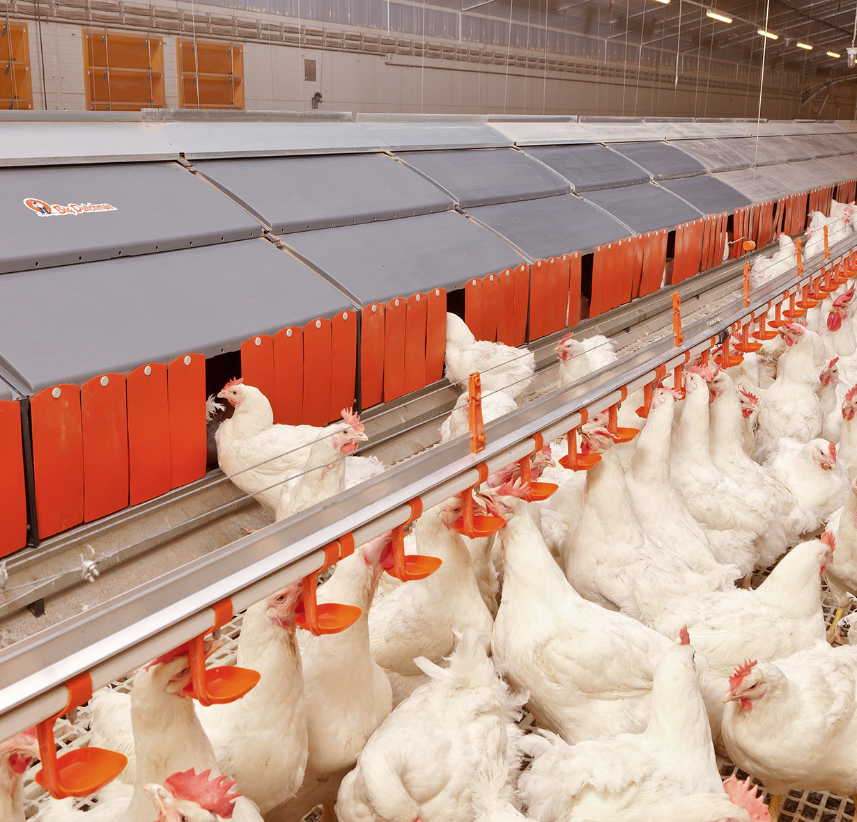
Housing for Broiler Breeders
Laying House Specs:
2/3 of the house have slats
Remaining 1/3 of the house is litter (where mating takes place)
Nests (eggs are collected mechanically or by hand)
Curtain-sided (walls are curtains that can be raised or lowered to maintain a comfortable house temperature)
Male and female feeding systems (females eat on slats, males eat on floor)
Drinkers
Evaporative cooling
Work room space
Egg cooler (kept at 65ºF)

Slide 29
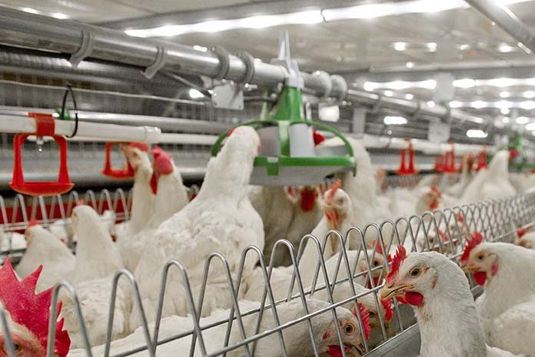
Housing for Broiler Breeders
Bait Stations:
It is vital that rodents and pests are kept away for biosecurity and egg numbers!
These need to be placed inside and/or outside of the house, with the hole against the wall ever 15-20 feet.

Slide 30
Poultry Science Curriculum References
Jessica Fife, UGA Dept. of Poultry Science Outreach Coordinator, UGA Dept. of Agricultural Leadership, Education, & Communication MAEE Candidate
Barry Croom, UGA Dept. of Agricultural Leadership, Education, & Communication Professor
Ashley Yopp, UGA Dept. of Agricultural Leadership, Education, & Communication Assistant Professor
Georgia Agriculture Education
Andrew Benson, UGA Dept. of Poultry Science Assistant Professor
Brian Jordan, UGA Dept. of Poultry Science Assistant Professor, UGA College of Veterinary Medicine Assistant Professor
University of Arkansas Bumpers College of Poultry Science – Poultry Science Dual Curriculum Course
Julia Gaskin, UGA Dept. of Crop and Soil Sciences Sr. Public Service Associate
Glendon Harris, UGA Dept. of Crop and Soil Sciences Professor & Extension Agronomist
Brian Kiepper, UGA Dept. of Poultry Science Associate Professor
Claudia Dunkley, UGA Dept. of Poultry Science Public Service Associate
Casey Ritz, UGA Dept. of Poultry Science Professor
USPOULTRY & USPOULTRY Poultry Science Curriculum
Tom Tabler, Mississippi State University Department of Poultry Science Extension Professor
Jacquie Jacob, University of Kentucky
Jeanna Wilson, UGA Dept. of Poultry Science Professor
Kelly Sweeney, UGA Dept. of Poultry Science Ph.D Candidate
Merck Veterinary Manual
University of Maryland Extension
Poultry Hub
Brian Fairchild, University of Georgia Department of Poultry Science Professor
Centers for Disease Control
National FFA Organization

